Slide 1
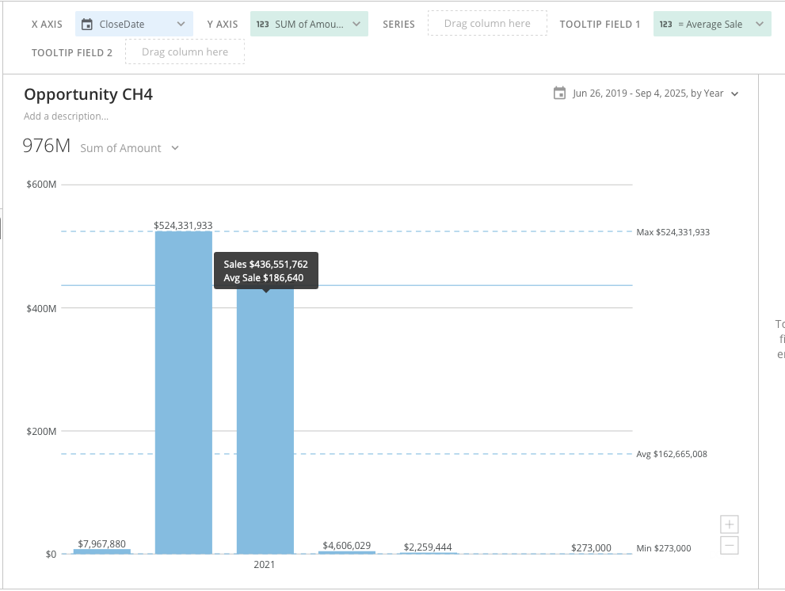

Slide 2
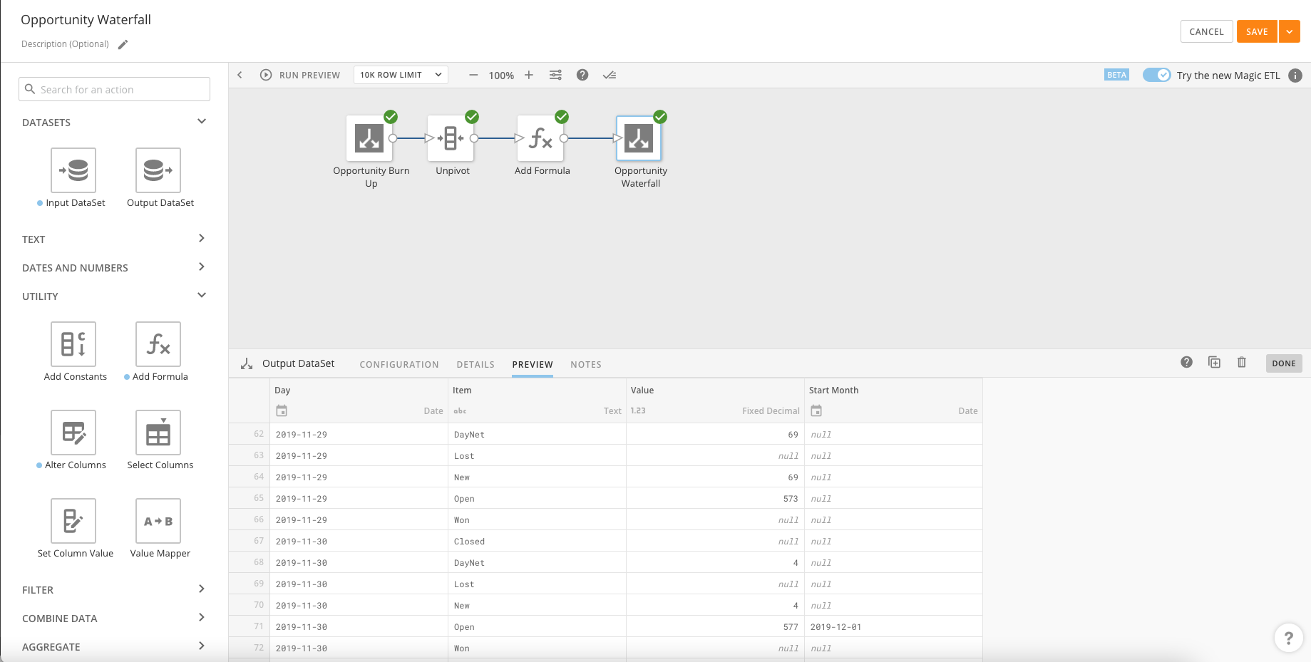

Slide 3
Where Am I Now?
How Did I Get Here?
Why?
Where will I Be?
What Changed?

